Slide 1
Ingest and transform data in Microsoft Fabric
Module 7

Slide 2
Module Objectives
Understand Transformation Option
1
Dealing with Challenging Data
2
Managing Error handing in your transformation process
3
Performing Data Analysis
4
Notes:
Tables in a Microsoft Fabric lakehouse are based on the Delta Lake storage format commonly used in Apache Spark. By using the enhanced capabilities of delta tables, you can create advanced analytics solutions.
Tables in a Microsoft Fabric lakehouse are based on the Linux foundation Delta Lake table format, commonly used in Apache Spark. Delta Lake is an open-source storage layer for Spark that enables relational database capabilities for batch and streaming data. By using Delta Lake, you can implement a lakehouse architecture to support SQL-based data manipulation semantics in Spark with support for transactions and schema enforcement. The result is an analytical data store that offers many of the advantages of a relational database system with the flexibility of data file storage in a data lake.

Slide 3
Understand data load design goals
Where is my data coming from?
Is the data nett new? or do you receive changes from existing datasets?
How often is the data being refreshed, added to or replaced?
What formats are the data coming in?
Is the data ingestible as-is? or are transformations and cleansing tasks required?
Which takes priority, loading or querying/analysis?
Notes:
Talking points
Loading data is essential because of the need to query or analyze the data to gain insights from it, so one of the main design goals in loading data, is to manage or minimize the impact on analytical workloads while loading the data with the highest throughput possible. Some of the questions that need to be asked when considering data loading are included in the slide.
Instructor notes and guidance.
Consider asking the students what they think are additional considerations that they have taken into account when looking at data load design goals
Recommended reading for this slide
https://docs.microsoft.com/en-us/learn/modules/use-data-loading-best-practices-azure-synapse-analytics/2-understand-design-goals

Slide 4
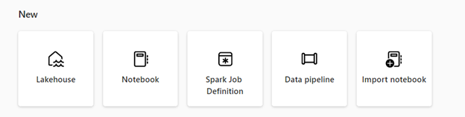
Fabric Data Engineering Options
Create and manage your data using a lakehouse
Design pipelines to copy data into your lakehouse
Use Spark job definitions to submit batch/streaming job to Spark cluster
Use notebooks to write code for data ingestion, preparation, and transformation
Notes:
Data engineering in Microsoft Fabric enables users to design, build, and maintain infrastructures and systems that enable their organizations to collect, store, process, and analyze large volumes of data.
Important
Microsoft Fabric provides various data engineering capabilities to ensure that your data is easily accessible, well-organized, and of high-quality. From the data engineering homepage, you can:
Create and manage your data using a lakehouse
Design pipelines to copy data into your lakehouse
Use Spark job definitions to submit batch/streaming job to Spark cluster
Use notebooks to write code for data ingestion, preparation, and transformation
Learn
Microsoft Fabric
Data Engineering
What is Data engineering in Microsoft Fabric?
Article
08/30/2023
In this article
Lakehouse
Apache Spark job definition
Notebook
Data pipeline
Next steps
Data engineering in Microsoft Fabric enables users to design, build, and maintain infrastructures and systems that enable their organizations to collect, store, process, and analyze large volumes of data.
Important
Microsoft Fabric is in preview.
Microsoft Fabric provides various data engineering capabilities to ensure that your data is easily accessible, well-organized, and of high-quality. From the data engineering homepage, you can:
Create and manage your data using a lakehouse
Design pipelines to copy data into your lakehouse
Use Spark job definitions to submit batch/streaming job to Spark cluster
Use notebooks to write code for data ingestion, preparation, and transformation
Lakehouse
Lakehouses are data architectures that allow organizations to store and manage structured and unstructured data in a single location, using various tools and frameworks to process and analyze that data. These tools and frameworks can include SQL-based queries and analytics, as well as machine learning and other advanced analytics techniques.
Apache Spark job definition
Spark job definitions are set of instructions that define how to execute a job on a Spark cluster. It includes information such as the input and output data sources, the transformations, and the configuration settings for the Spark application. Spark job definition allows you to submit batch/streaming job to Spark cluster, apply different transformation logic to the data hosted on your lakehouse along with many other things.
Notebook
Notebooks are an interactive computing environment that allows users to create and share documents that contain live code, equations, visualizations, and narrative text. They allow users to write and execute code in various programming languages, including Python, R, and Scala. You can use notebooks for data ingestion, preparation, analysis, and other data-related tasks.
Data pipeline
Data pipelines are a series of steps that can collect, process, and transform data from its raw form to a format that you can use for analysis and decision-making. They're a critical component of data engineering, as they provide a way to move data from its source to its destination in a reliable, scalable, and efficient way.

Slide 5
Notebooks

Slide 6
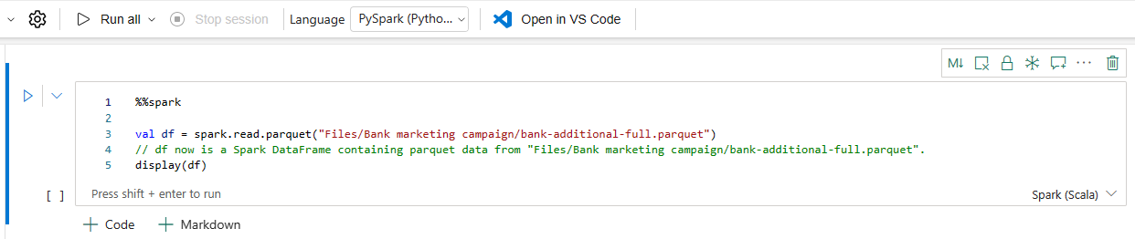
Fabric Notebook Languages
PySpark (Python)
Spark (Scala)
Spark SQL
SparkR
Notes:
Set a primary language
Microsoft Fabric notebooks currently support four Apache Spark languages:
PySpark (Python)
Spark (Scala)
Spark SQL
SparkR
You can set the primary language for new added cells from the dropdown list in the top command bar.
Use multiple languages
You can use multiple languages in a notebook by specifying the language magic command at the beginning of a cell, you can also switch the cell language from the language picker. The following table lists the magic commands to switch cell languages.

Slide 7
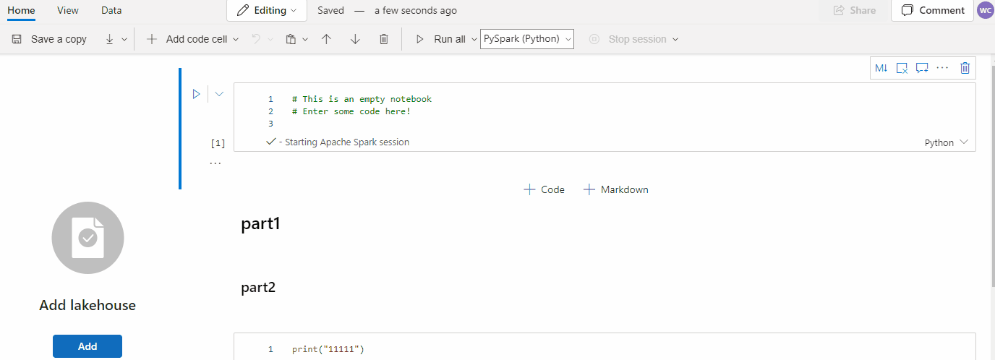
Fabric Code Snippets
Notes:
Microsoft Fabric notebooks provide code snippets that help you write commonly used code patterns easily, like:
Reading data as a Spark DataFrame, or
Drawing charts with Matplotlib.
Snippets appear in Shortcut keys of IDE style IntelliSense mixed with other suggestions. The code snippets contents align with the code cell language. You can see available snippets by typing Snippet or any keywords appear in the snippet title in the code cell editor. For example, by typing read you can see the list of snippets to read data from various data sources.

Slide 8
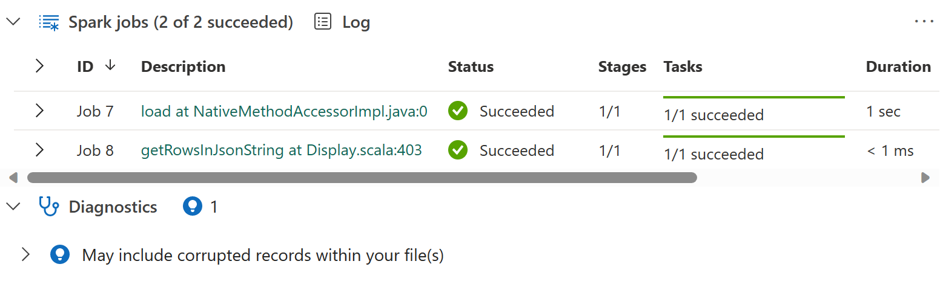
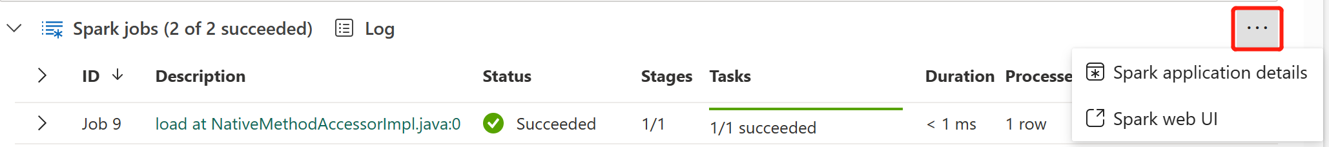
Manage Spark Jobs
Notes:
The Microsoft Fabric notebook is Spark based. Code cells are executed on the spark cluster remotely. A Spark job progress indicator is provided with a real-time progress bar appears to help you understand the job execution status. The number of tasks per each job or stage help you to identify the parallel level of your spark job. You can also drill deeper to the Spark UI of a specific job (or stage) via selecting the link on the job (or stage) name.
You can also find the Cell level real-time log next to the progress indicator, and Diagnostics can provide you with useful suggestions to help refine and debug the code.
In More actions, you can easily navigate to the Spark application details page and Spark web UI page.

Slide 9
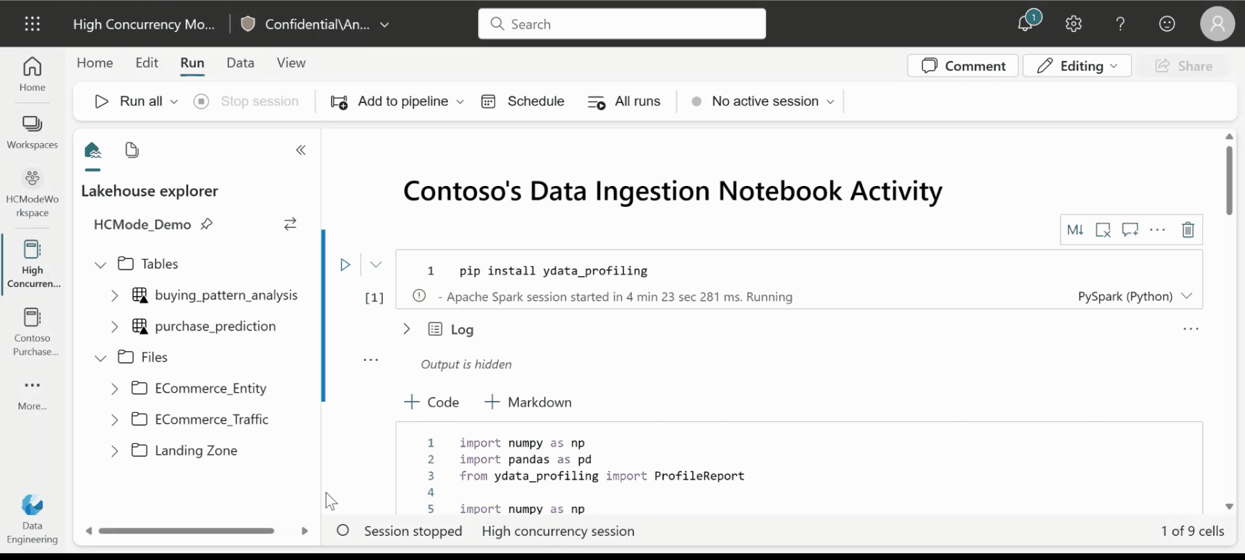
Fabric Notebook High Concurrency
Notebooks should be run by the same user
Notebooks should have the same default lakehouse
Notebooks should have the same Spark compute configurations
Notebooks should have the same library packages
Notes:
When you run a notebook in Microsoft Fabric, an Apache Spark session is started and is used to run the queries submitted as part of the notebook cell executions. With High Concurrency Mode enabled, there's no need to start new spark sessions every time to run a notebook.
If you already have a High Concurrency session running, you could attach notebooks to the high concurrency session getting a spark session instantly to run the queries and achieve a greater session utilization rate.
The high concurrency mode-based session sharing is always within a single user boundary. The notebooks need to have matching spark configurations, should be part of the same workspace, share the same default lakehouse and libraries to share a single spark session.

Slide 10
Data Pipelines

Slide 11



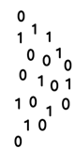



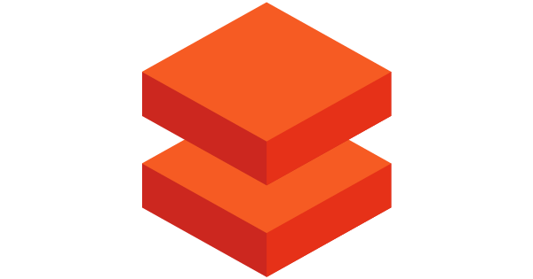
Data integration with Fabric Data Factory or Pipelines
@
Triggers
Parameters
Linked Service
IR
Integration
Runtime
CF
Control
Flow
Pipeline
Data Lake Store
1
Activities
Azure Databricks
Dataset
Notes:
<< NOTE. This slide also appears in module 5, and is included if you need to use it in this module>>
Talking points
Let’s have a closer look at the components of Azure Data Factory
Linked services
Linked services are much like connection strings, which define the connection information that's needed for Data Factory to connect to external resources. Think of it this way: a linked service defines the connection to the data source, and a dataset represents the structure of the data. For example, an Azure Storage-linked service specifies a connection string to connect to the Azure Storage account. Additionally, an Azure blob dataset specifies the blob container and the folder that contains the data.
Linked services are used for two purposes in Data Factory:
To represent a data store that includes, but isn't limited to, an on-premises SQL Server database, Oracle database, file share, or Azure blob storage account. For a list of supported data stores, see the copy activity article.
To represent a compute resource that can host the execution of an activity. For example, the HDInsight Hive activity runs on an HDInsight Hadoop cluster. For a list of transformation activities and supported compute environments, see the transform data article.
Datasets
Datasets represent data structures within the data stores, which simply point to or reference the data you want to use in your activities as inputs or outputs.
Activity
Activities represent a processing step in a pipeline. For example, you might use a copy activity to copy data from one data store to another data store. Similarly, you might use a Hive activity, which runs a Hive query on an Azure HDInsight cluster, to transform or analyze your data. Data Factory supports three types of activities: data movement activities, data transformation activities, and control activities.
Pipeline
A data factory might have one or more pipelines. A pipeline is a logical grouping of activities that performs a unit of work. Together, the activities in a pipeline perform a task. For example, a pipeline can contain a group of activities that ingests data from an Azure blob, and then runs a Hive query on an HDInsight cluster to partition the data.
The benefit of this is that the pipeline allows you to manage the activities as a set instead of managing each one individually. The activities in a pipeline can be chained together to operate sequentially, or they can operate independently in parallel.
Triggers
Triggers represent the unit of processing that determines when a pipeline execution needs to be kicked off. There are different types of triggers for different types of events.
Pipeline runs
A pipeline run is an instance of the pipeline execution. Pipeline runs are typically instantiated by passing the arguments to the parameters that are defined in pipelines. The arguments can be passed manually or within the trigger definition.
Parameters
Parameters are key-value pairs of read-only configuration. Parameters are defined in the pipeline. The arguments for the defined parameters are passed during execution from the run context that was created by a trigger or a pipeline that was executed manually. Activities within the pipeline consume the parameter values.
A dataset is a strongly typed parameter and a reusable/referenceable entity. An activity can reference datasets and can consume the properties that are defined in the dataset definition.
A linked service is also a strongly typed parameter that contains the connection information to either a data store or a compute environment. It is also a reusable/referenceable entity.
Control flow
Control flow is an orchestration of pipeline activities that includes chaining activities in a sequence, branching, defining parameters at the pipeline level, and passing arguments while invoking the pipeline on-demand or from a trigger. It also includes custom-state passing and looping containers, that is, For-each iterators.
Integration Runtime
Integration Runtime is referenced by the linked service or activity, and provides the compute environment where the activity either runs on or gets dispatched from. Data Factory offers three types of Integration Runtime, and you should choose the type that best serve the data integration capabilities and network environment needs you are looking for. These three types are:
Azure - Copying between two cloud data sources:
Self-hosted - Copying between a cloud data source and a data source in private network
Azure-SSIS - Copying between two data sources in private network (only supported in Azure Data Factory, not Azure Synapse Pipelines)
Instructor notes and guidance.
This slide is a build slide, please make sure that you are familiar with the order that the items appear.
Click 1 – Enable you to speak about Linked Services:
Click 2 – Use Data Lake Store as a storage resource example
Click 3 – Use Databricks as a compute resource example
Click 4 – Enables you to talk about the Dataset object
Click 5 – this is a graphic to show a flow of data
Click 6 – Bring up the word activity
Click 7 – shows a rotating cog to reflect a single activity
Click 8 – removes the word activity
Click 9 - shows multiple rotating cogs to reflect multiple activities
Click 10 – Shows a funnel with the word pipeline to show that activities are grouped into a pipeline.
Click 11 – The word trigger appears with a circular arrow
Click 12 – The circular arrow rotates to indicate that a pipeline is triggered to execute
Click 13 - nothing happens
Click 14 – a number 1 appears out of the data and flows through the pipeline into the data set to reflect data being transformed by the activities in a pipeline
Click 15 - The word Parameters with an @ symbol appears
Click 16 – The word Integration runtime appears with an IR icon
Click 17 - The word Control Flow appears with the CF icon
Recommended reading for this slide
https://docs.microsoft.com/en-us/learn/modules/data-integration-azure-data-factory/

Slide 12
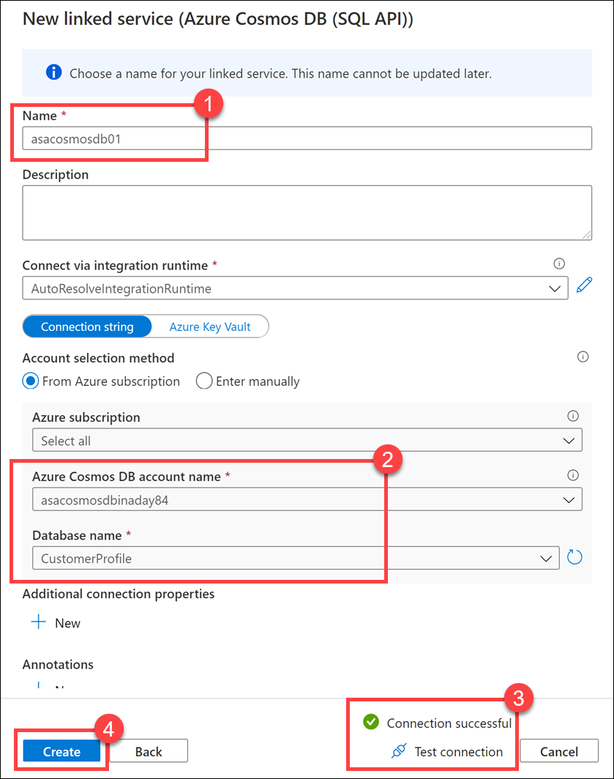
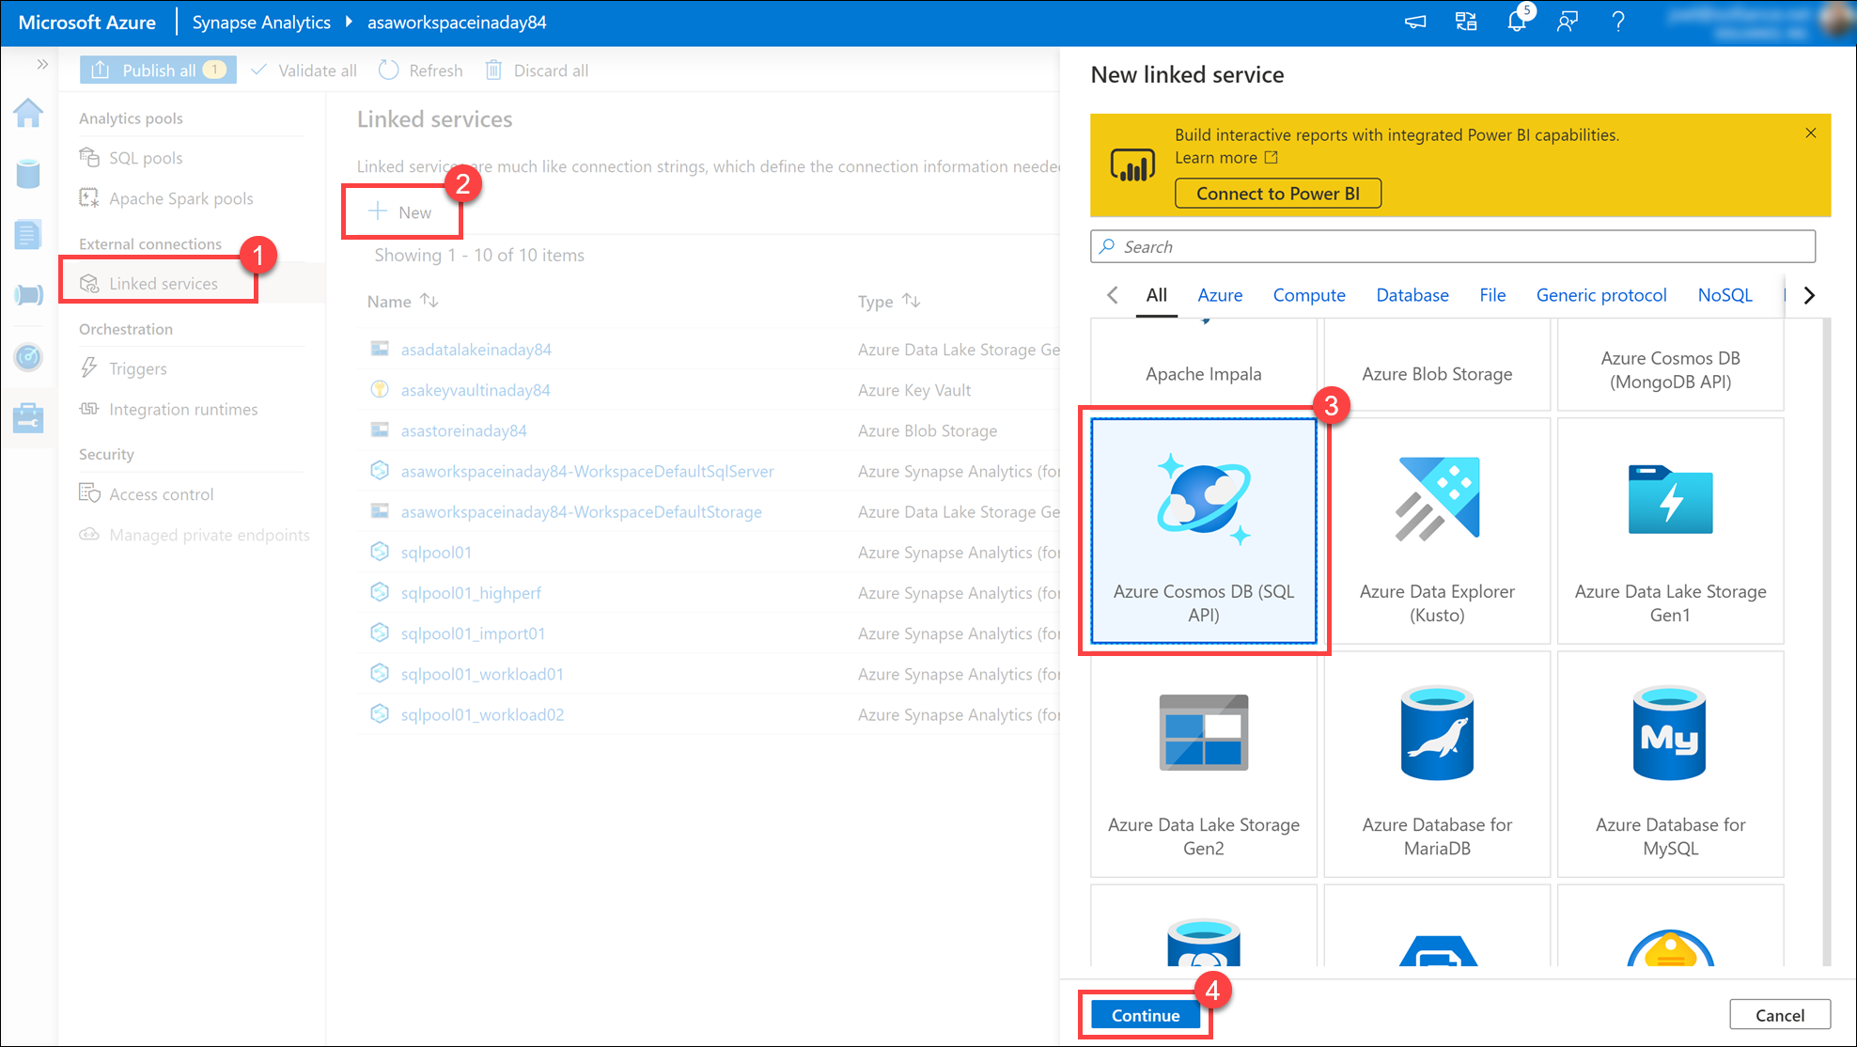
Linked Services
Notes:
Talking points
Before you create a dataset, you must create a linked service to link your data store to the data factory/Synapse pipeline. Linked services are much like connection strings, which define the connection information needed for Data Factory to connect to external resources. There are over 100 connectors that can be used to define a linked service.
A linked service in Data Factory can be defined using the Copy Data Activity in the ADF designer, or you can create them independently to point to a data store or a compute resources.
Instructor notes and guidance.
Use the example on the slide to highlight to students that you can create linked services through a UI, but you can also create then programmatically using JSON. You could use the following example if anyone asks for an example of the syntax
{
"name": "<Name of the linked service>",
"properties": {
"type": "<Type of the linked service>",
"typeProperties": {
"<data store or compute-specific type properties>"
},
"connectVia": {
"referenceName": "<name of Integration Runtime>",
"type": "IntegrationRuntimeReference"
}
}
}
Recommended reading for this slide
https://docs.microsoft.com/en-us/learn/modules/data-integration-azure-data-factory/8-create-linked-services?ns-enrollment-type=LearningPath&ns-enrollment-id=learn.wwl.data-integration-scale-azure-data-factory

Slide 13
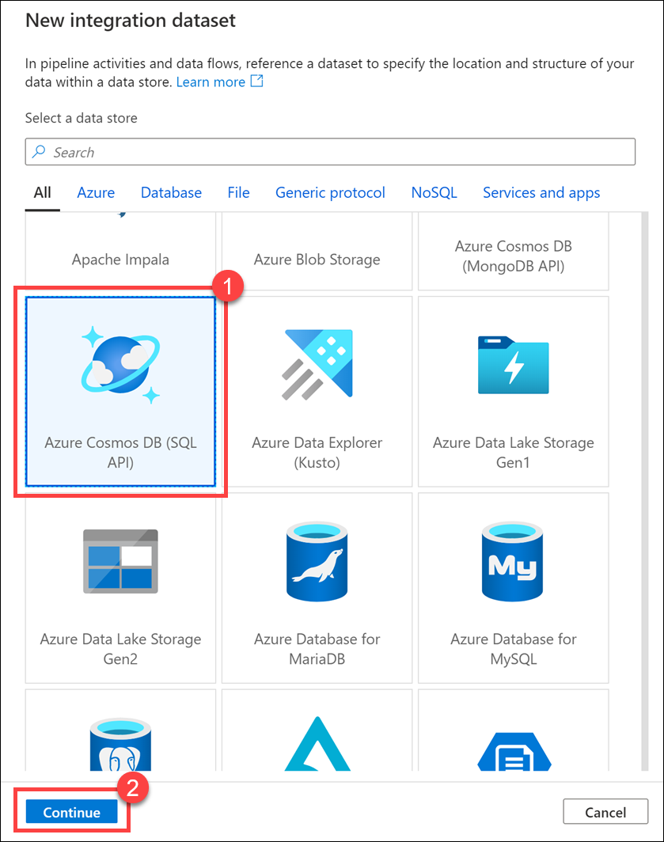
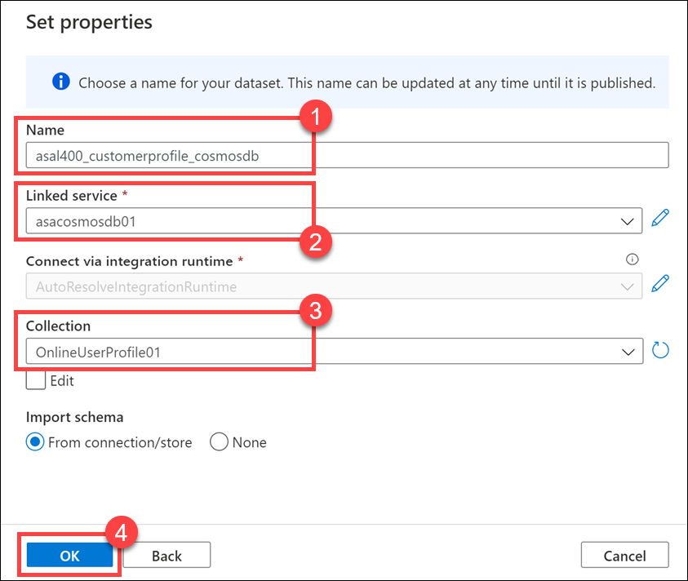
Datasets
Notes:
Talking points
A dataset is a named view of data that simply points or references the data you want to use in your activities as inputs and outputs. Datasets identify data within different data stores, such as tables, files, folders, and documents. For example, an Azure Blob dataset specifies the blob container and folder in Blob storage from which the activity should read the data.
Before you create a dataset, you must create a linked service to link your data store to the data factory.
Instructor notes and guidance.
Share with the students that during the lab, they will be creatin more than three integration datasets against different types of data stores ranging from Azure Data Lake, Synapse Analytics and Cosmos DB. Ask the students to think about the datasets and linked services they would need to create to build solutions within their own organization
Recommended reading for this slide
https://docs.microsoft.com/en-us/learn/modules/data-integration-azure-data-factory/9-create-datasets

Slide 14
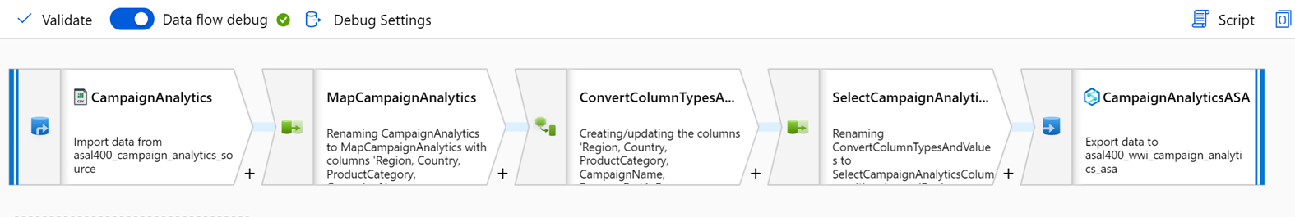
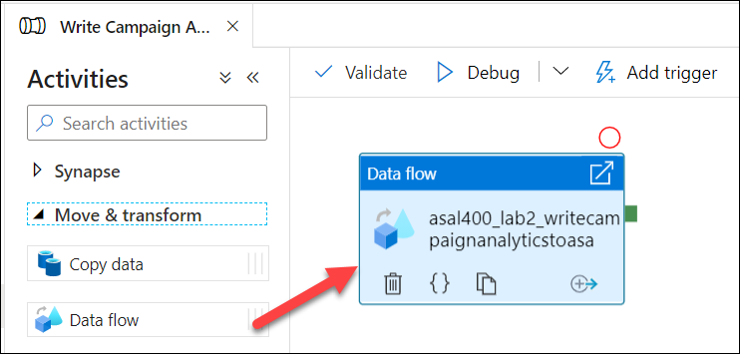
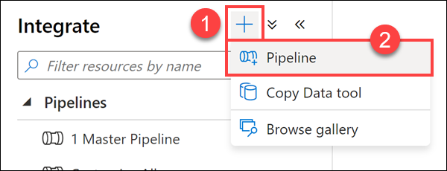
Activities and pipelines
Notes:
Talking points
A data factory can have one or more pipelines. A pipeline is a logical grouping of activities that together perform a task. For example, a pipeline could contain a set of activities that ingest and clean log data, and then kick off a mapping data flow to analyze the log data. The pipeline allows you to manage the activities as a set instead of each one individually. You deploy and schedule the pipeline instead of the activities independently.
The activities in a pipeline define actions to perform on your data. For example, you may use a copy activity to copy data from SQL Server to an Azure Blob Storage. Then, use a data flow activity or a Databricks Notebook activity to process and transform data from the blob storage to an Azure Synapse Analytics pool on top of which business intelligence reporting solutions are built.
Data Factory has three groupings of activities: data movement activities, data transformation activities, and control activities. An activity can take zero or more input datasets and produce one or more output datasets.
Instructor notes and guidance.
Thinking about the organization of the activities that take place within a pipeline is an important part of creating pipelines. You don’t want to create one monolithic pipeline that manages all of your data integration pipelines as it will become too cumbersome to manage and develop. Typically, you will break pipelines down into discrete units of manageable data integration pipelines. Azure Data Factory/Synapse pipeline has an execute pipeline activity that enables you to control the execution of the pipelines to manage this.
Recommended reading for this slide
https://docs.microsoft.com/en-us/learn/modules/data-integration-azure-data-factory/10-create-activities-pipelines

Slide 15
Summary
Delta tables add a great deal of functionality and allow Data Lakehouse architectures to be more robust
Spark supports a wide variety of methods for interacting with, creating, and ingesting data into delta tables
You can take advantage of time travel in delta tables to do temporal queries
You can use delta tables as a source or target for streaming data with Spark

Slide 16

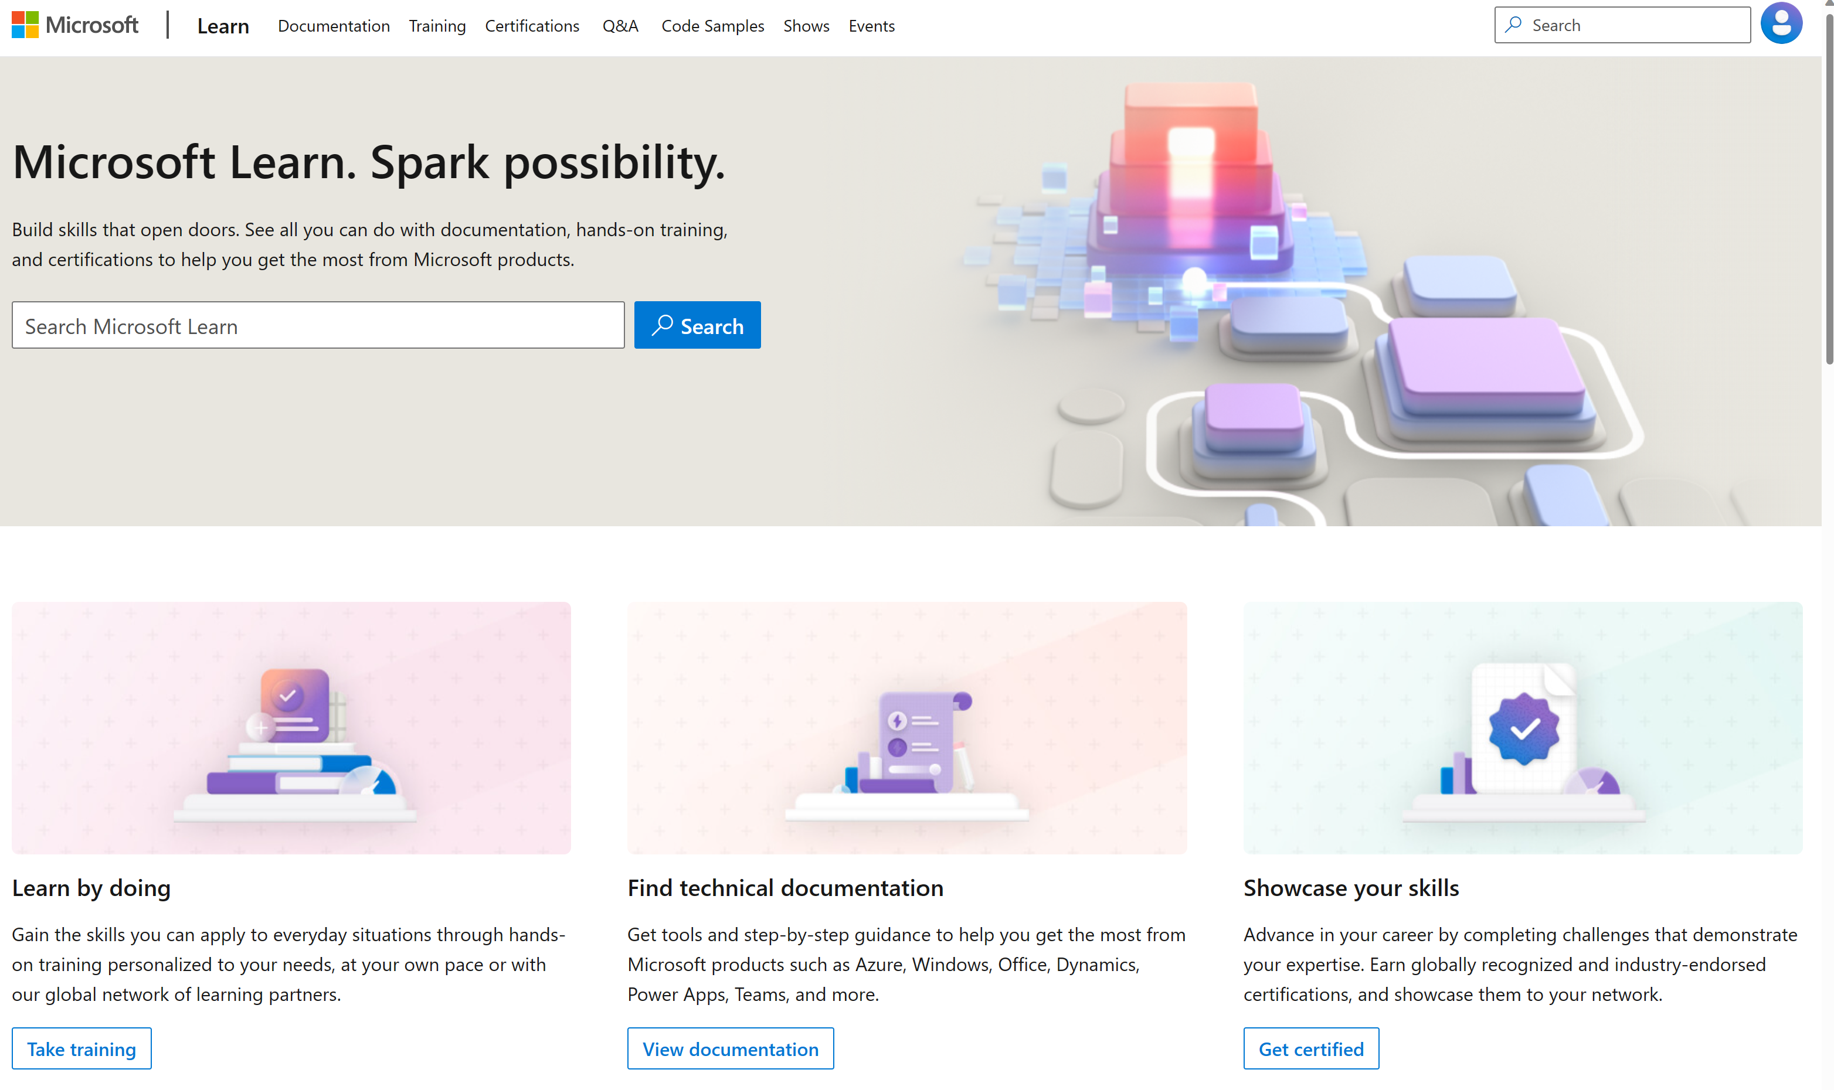
Microsoft Learn Demo
Microsoft Learn: Build skills that open doors in your career

Slide 17
Readiness and Enablement Links
The Microsoft Federal Team is here to help you accelerate customers' digital transformation. Microsoft Federal has tailored to make your organizations skilling journey successful. From the Business Decision Maker to the technical community and end-users, Microsoft provides customers with access to endless skilling resources. Below you will find links to these resources:
Get training tailored to your organization's needs: Find learning paths for specific roles in your organization, plus course recommendations based on technology, skill level, and solution area: Training | Learning Portal (microsoft.com)
Events Calendar - US Partner Community Blog – Microsoft
In addition to the above, the Microsoft Federal Team can address the needs of your non-technical community of your learners through:
Skilling Hours - Readiness and Enablement: Skilling our Federal Customers and Partners (office.com)
Microsoft Learning Portal: A closer look at Azure through training modules and gamified learning
Microsoft Learning Portal
Additional Learning Resources:
Get started with Azure – Introduction | Microsoft Azure
Microsoft Learn (path-based)
Exam-based: Select filters: Azure, D365, M365, Power Platform, and more
Microsoft Virtual Training Days – Virtual Instructor Led
Microsoft Technology Center - Work through your Account Manager
Home - Microsoft Tech Community
Microsoft Reactor | Microsoft Developer – Virtual Instructor Led

